Slide 1
March 2nd Sprint Presentation
Capstone Defence

Slide 2
User Stories for Sprint 4
As a gamer, I want to be able to be shown that I’m logged in.
As a gamer, I want to be able to see the score I’m accumulating.
As a gamer, I want my score to be posted on the leaderboard after the game has ended.
As a gamer, I want the resume functionality to work after I pause the game.
As a gamer, I want to be able to view the circumference of the cannons to help me with the game.
As a gamer, I want the world to spawn with different assets.
As a gamer, I want to be able to play in different worlds with different scenery and characteristics.

Slide 3
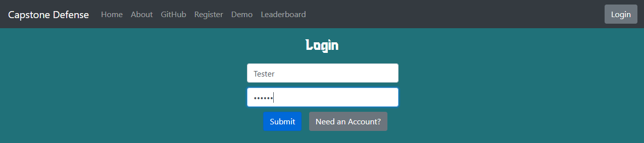
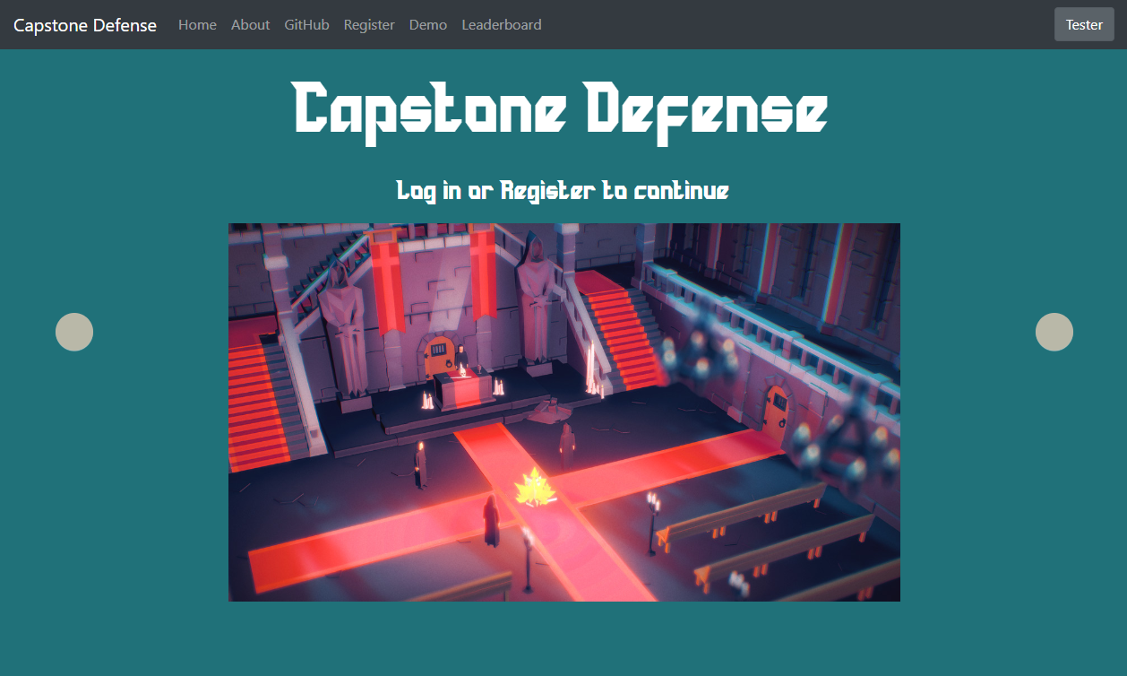
User Status After Logging In
Added indication that a user is logged in
Logic was also added to see if a user has a session running
Clicking the button again will take the user to their user profile

Slide 4
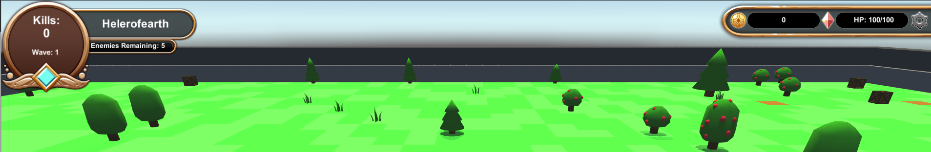
Scoring Algorithm and Accumulation
Enemies Remaining was added
Waves was moved to kills
Current issues with spawning more mobs than Enemies Remaining

Slide 5
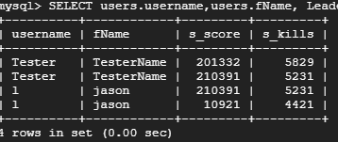
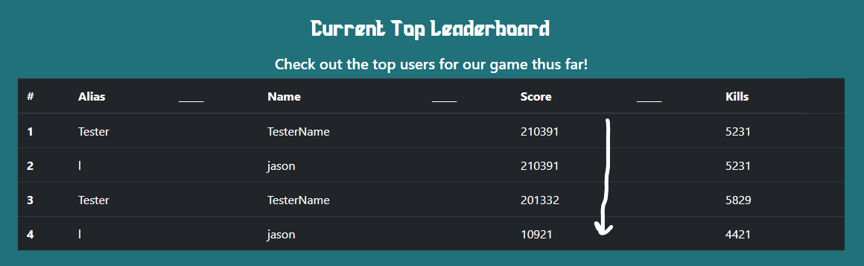
Leaderboard Functionality
Leaderboard API is ready to go
Leaderboards are pulling information from DB
Homepage displays top 10
Account displays top 5
Leaderboards displays 50
Connection to unity game is almost complete

Slide 6
Pause and Resume Functionality
Landing page no longer has resume button.
Menu when accessed from in game does have resume button
Lists are generated when scene is created
These lists are saved
The lists can be used to instantiate objects to recreate the scene
We don’t need to store object positions because we can derive them from index, so long as there are dummy values where there are no objects.
(X,Y,Z)(i) = (2*Floor(i/50)+1, Y(obj), 2((i-1)%49)+2)

Slide 7
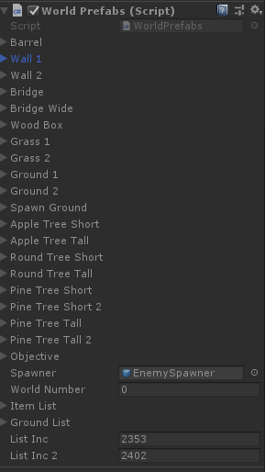
Asset Spawning / World Generation
Better world Generation is implemented
Wider range of assets spawn
Added different ground coloration for enemy spawners

Slide 8
Quality Assurance Testing
WEBSITE FUNCTIONALITY
Mobile testing
IOS and Android now have a functional website with appropriate navbar. Issue from Sprint 3 is resolved.
Unity demo functional across all browsers.
New login location on upper right corner of webpages function properly
New button on top right corner of the page successfully redirects user to their own user profile pages
User Account Creation
Receiving verification email to an iCloud email account sends a invalid link. Testing with Gmail email address works properly. This is because on emails other than Gmail, there is no period before .org, resulting in an invalid link.
New login location on upper right corner of webpages function properly.
New button on top right corner of the page successfully redirects user to their own user profile pages.
Website Design Issues:
Clicking “login” or “register” should be hyperlinked to their corresponding webpages. This needs to be done before project completion.
Log out option needs to be more visible for users and not buried in the user account page.
Leaderboard needs to be connected and updated properly with new scores.
Need to give users a way to change email addresses linked to the account.
Changing email addresses in the user profile page needs to send out a new email verification code.

Slide 9
Quality Assurance Testing
Game functionality
New game new world generation is functional, new maps, asset locations and collisions are all working as
intended.
Tower projectile animation and function are working as intended, sound still needs to be decided on.
Enemy health showing as intended.
Tower and main structure health needs to be more visually noticeable by the player.
Enemy animations are working as intended.
Tower tracking animations working as intended.
Possibly need to have visual indicator of tower placements and effective tower range so that the players have a better understanding of how the towers effective ranges.
Need to finalize and implement wave functionality.
UI/UX functionality
Gear icon implemented in the UI which brings up the paused menu, working as intended.
Resource management bar is being updated as intended using intended resources on every newly generated map.
Clicking “new game” starts a scene and a sound plays. This is working as intended.
Settings gear icon presents landing screen. This is functional.
Resume works properly.
Quit button on the landing screen is not functional.
Settings button is not functional.

Slide 10
Goals for Sprint 5 (Game)
Implement settings and quit buttons on pause screen
Adding various sounds to the game to give it “Life”
Making health system more visible
Changing UI around to our new UI
Working on better collision
Adding more “Skins” for the terrain (Winter and Dungeon)
Finish the code cleanup

Slide 11
Goals for Sprint 5 (Website)
Various website usability updates
Making login button a drop down to show logout button
Adding a forgot password link
Better tracking of leaderboard scores
Implement API so client (Unity Player) can send REQUESTS
Cleaning up UI
Adding images/fixing formatting
Port over remaining PHP logic to python

Slide 12
Demo

